Slide 1
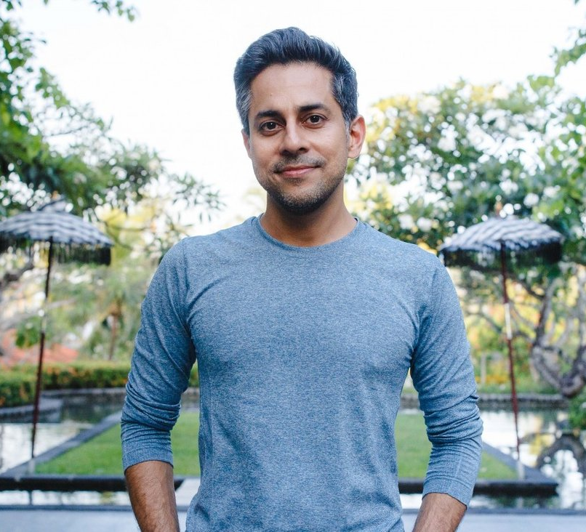
Vishen Lakhaini
BCVS Practical Presentation

Slide 2
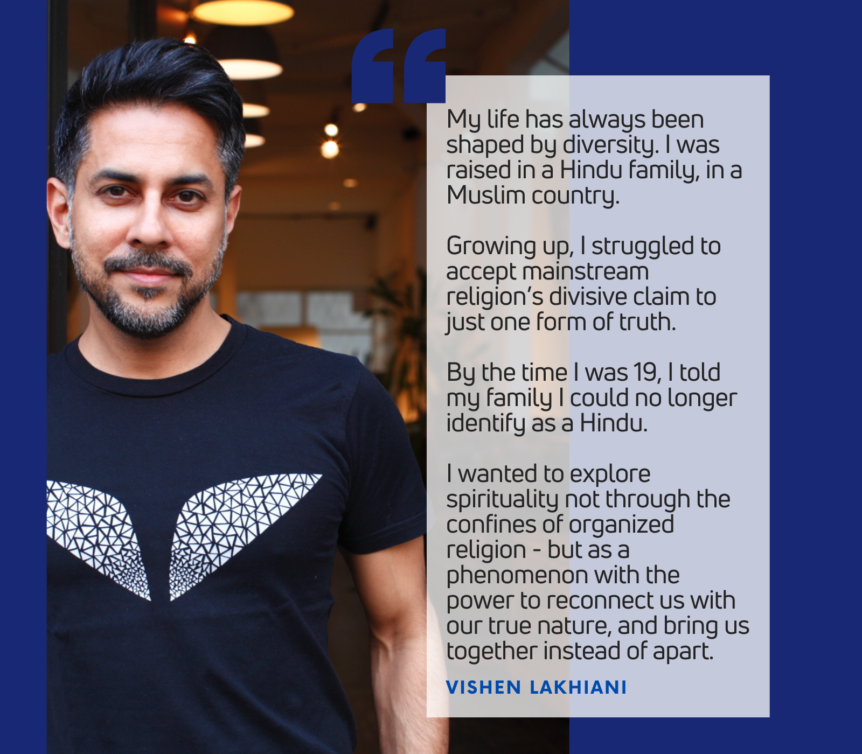
Introduction

Slide 3
Workplace Charisma
Get team together and figure out code of values.
Hire people with belief.
Healthy beliefs and habits.
10 things
1st Friday of the month

Slide 4
Start of the Journey
Life in USA
Moving back to Malaysia
Establishing Mind Valley
An ordinary AD

Slide 5
The Vishen Lakhiani Personality
Gratitude
Forgiveness
Embrace our authenticity
Humility
Kindness
Playfulness
Open to learn from others

Slide 6
Mantra for effective teamwork
Recognising the potentials of the employees
Empowering them and making them believe in themselves
Focusing on individual growth
Motivating them to take risks and work towards the goal

Slide 7
Employees Motivation
Constant HR support
Flexible working hours
It is very metrics driven
Countless opportunity for personal growth

Slide 8
THANK YOU - keep bending reality

